Slide 1

CAP615 PROGRAMMING IN JAVA
Lecture #1

Slide 2
Today’s topics
Introduction to Java : basic java concepts:
Introduction about the java programming development tools,
Java keywords,
variables,
data types,
operators and
control statements

Slide 3
Introduction about the java programming development tools
What is development tools in Java?
JDK (Java Development Kit)
JDK
JDK is Java Development Kit. The Java Development Kit (JDK) is a software development environment which is used to develop Java applications.

Slide 4
JRE (Java Runtime Environment) is an installation package that provides an environment to only run(not develop) the java program(or application)onto your machine. JRE is only used by those who only want to run Java programs.

Slide 5
JVM (Java Virtual Machine) is a very important part of both JDK and JRE because it is contained or inbuilt in both. Whatever Java program you run using JRE or JDK goes into JVM and JVM is responsible for executing the java program line by line, hence it is also known as an interpreter.

Slide 6
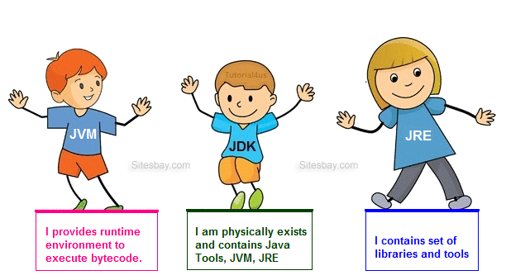
Working of JVM, JDK and JRE

Slide 7
There are different types of Java editions are available to develop applications:
Java Standard Edition (JSE)
Java Enterprise Edition(JEE)
Java Micro Edition(JME)

Slide 8
Java Standard Edition (JSE)
JSE can be used to develop client-side standalone (independant) applications or applets.
Java Enterprise Edition (JEE)
JEE can be used to develop server-side applications such as Java servlets and Java ServerPages.
Java Micro Edition (JME).
JME can be used to develop applications for mobile devices such as cell phones.

Slide 9
How to achieve encapsulation in JAVA?
Ans:
Using data member as a private and setter, getter accessor methods as a public to access these private data members.

Slide 10
How to define class?
Class is a collection of data members and member methods.
Class is a collection of similar type of objects.

Slide 11
Syntax to declare a class:
class <class_name>
{
data_member;
member_method;
}
Defining scope of
The class
Class Name:
Data Member:
Member Methods:
Class Diagram(UML)

Slide 12


